Slide 1

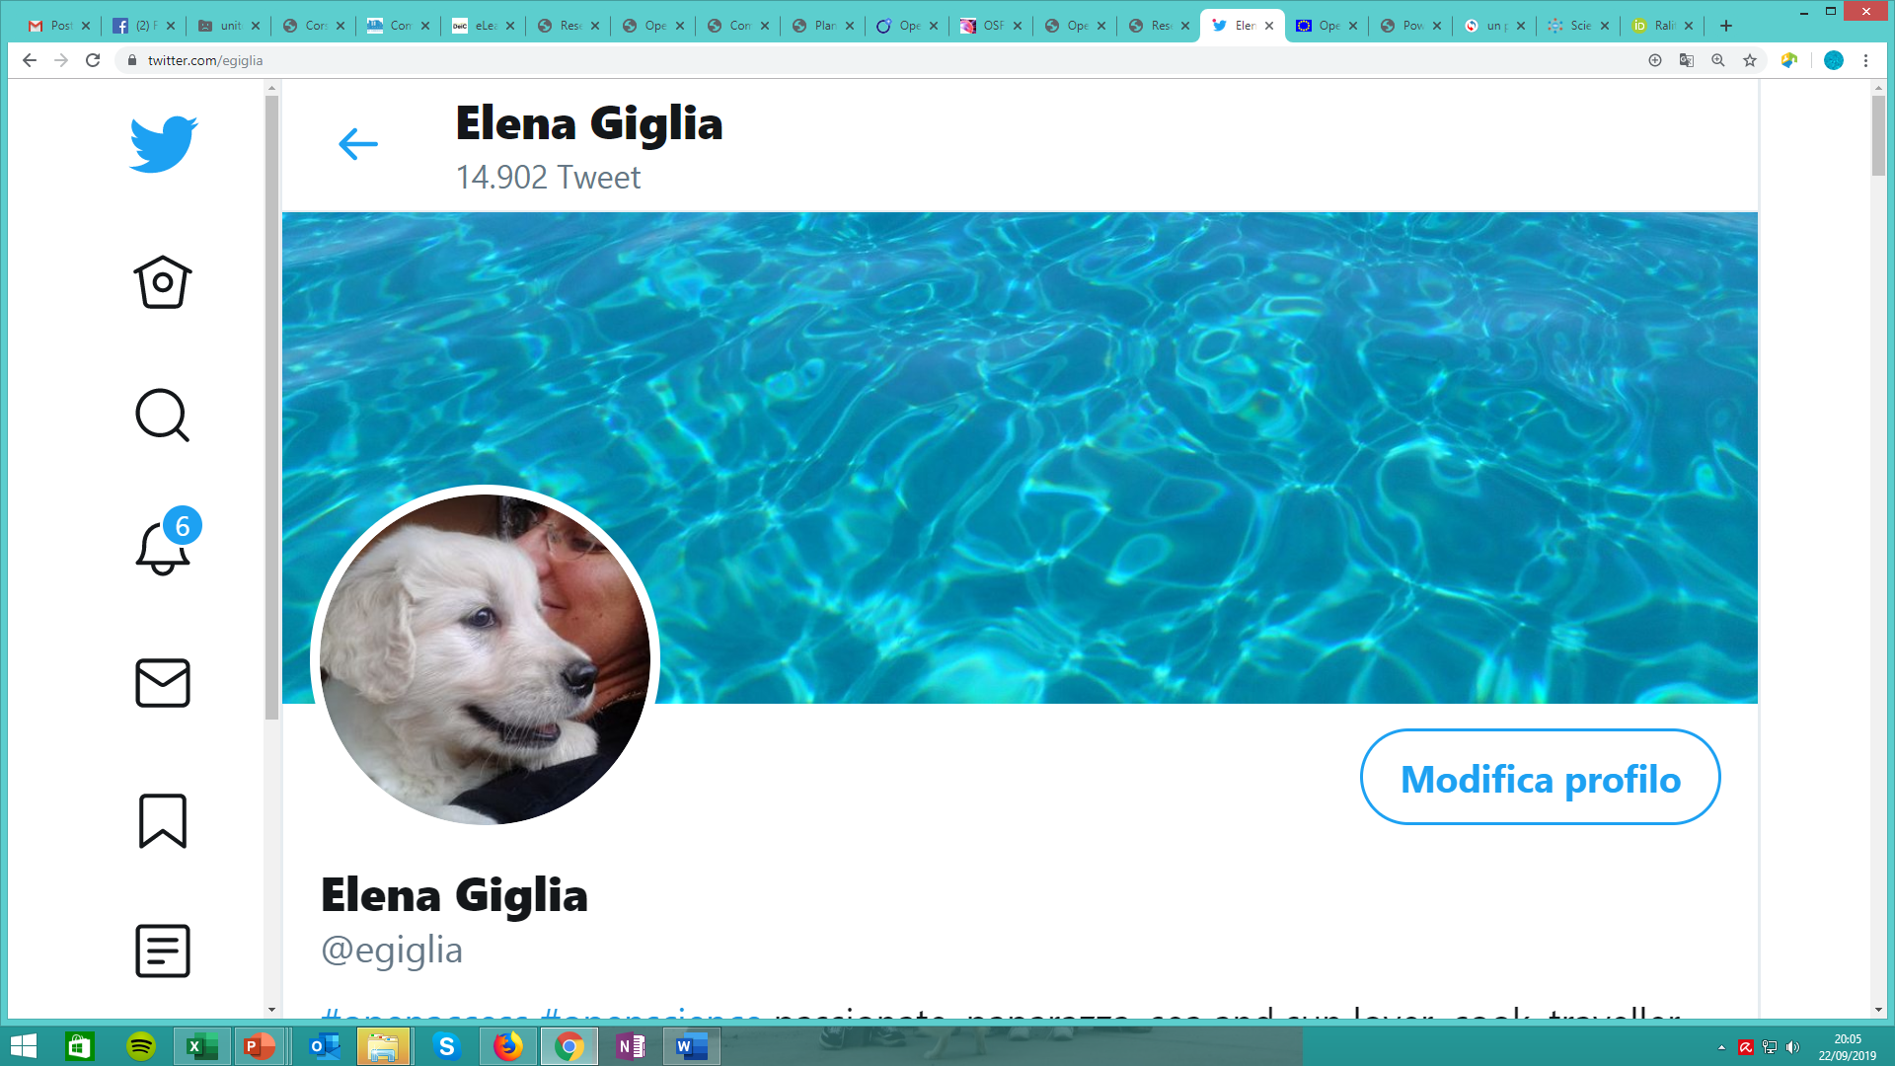
10 questions and 3 points on Open Science Elena Giglia
SISSA, Trieste, May 2nd 2022
elena.giglia@unito.it
@egiglia
This work is licensed under a Creative Commons Attribution 4.0 International License.. Photos are mine. Feel free to reuse from Flickr/eg65

Slide 2
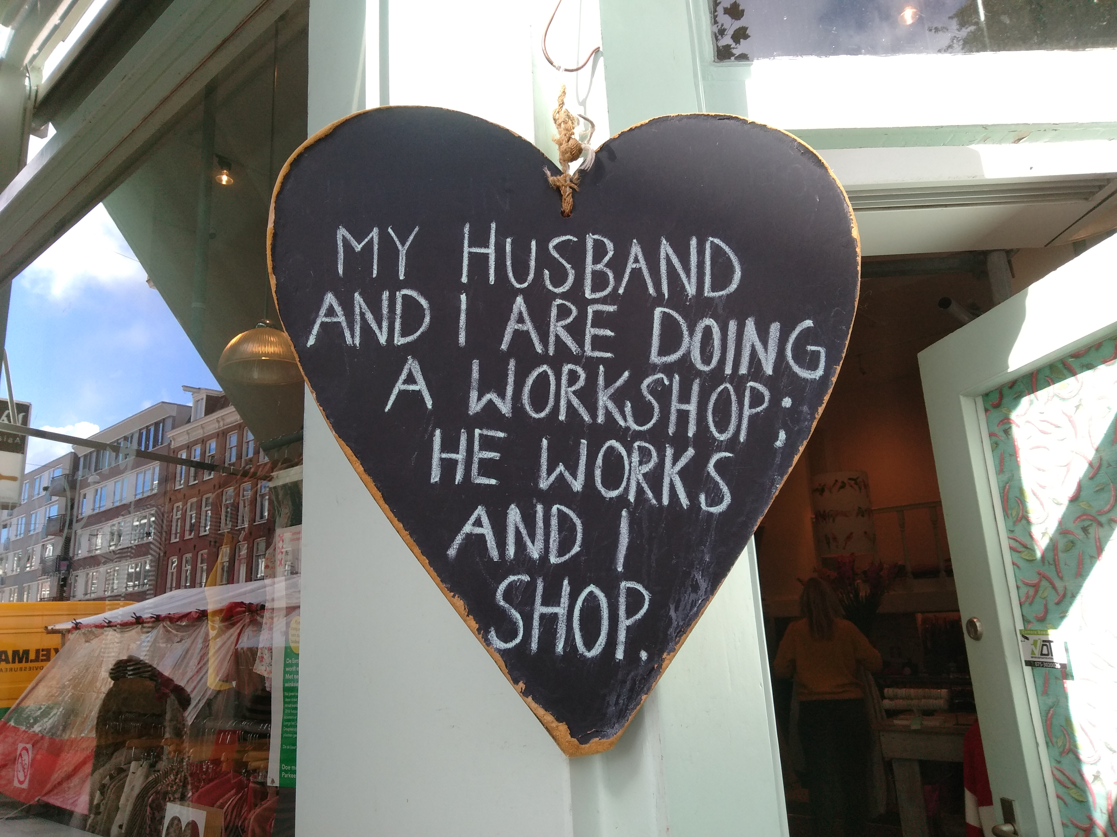
Today in a nutshell
SOME ISSUES WILL BE ADDRESSED TODAY BY STEFANO BIANCO, OTHERS TOMORROW IN THE COURSE
…setting the scene for this 2 days of «Open» with 10 [critical] questions raising issues on your daily workflow…
… to see the reasons why Open Science is not the unptenth administrative burden…
…and why we should care, in the view of Horizon Europe, the EOSC and FAIR data

Slide 3
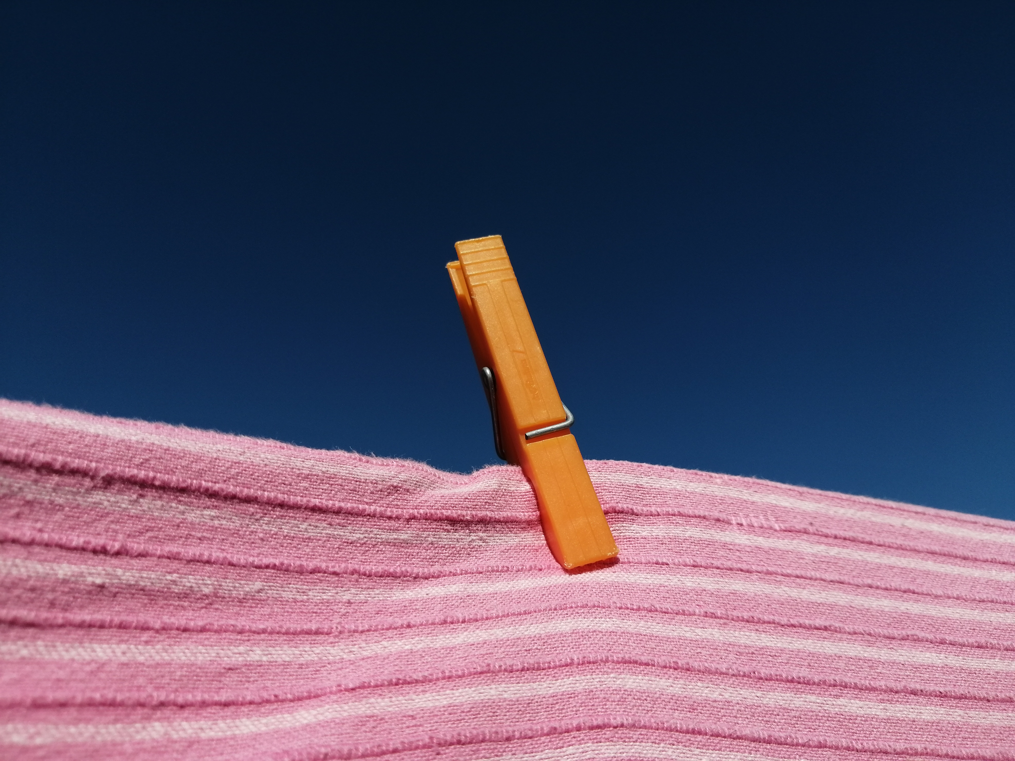
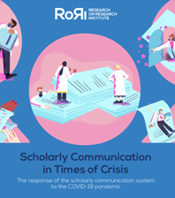
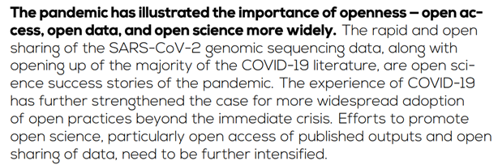
[point #1]
MY OWN QUESTION:
WHAT ELSE DO WE NEED BUT COVID TO SEE THE IMMEDIATE NEED FOR OPEN SCIENCE?
Dec.2021

Slide 4
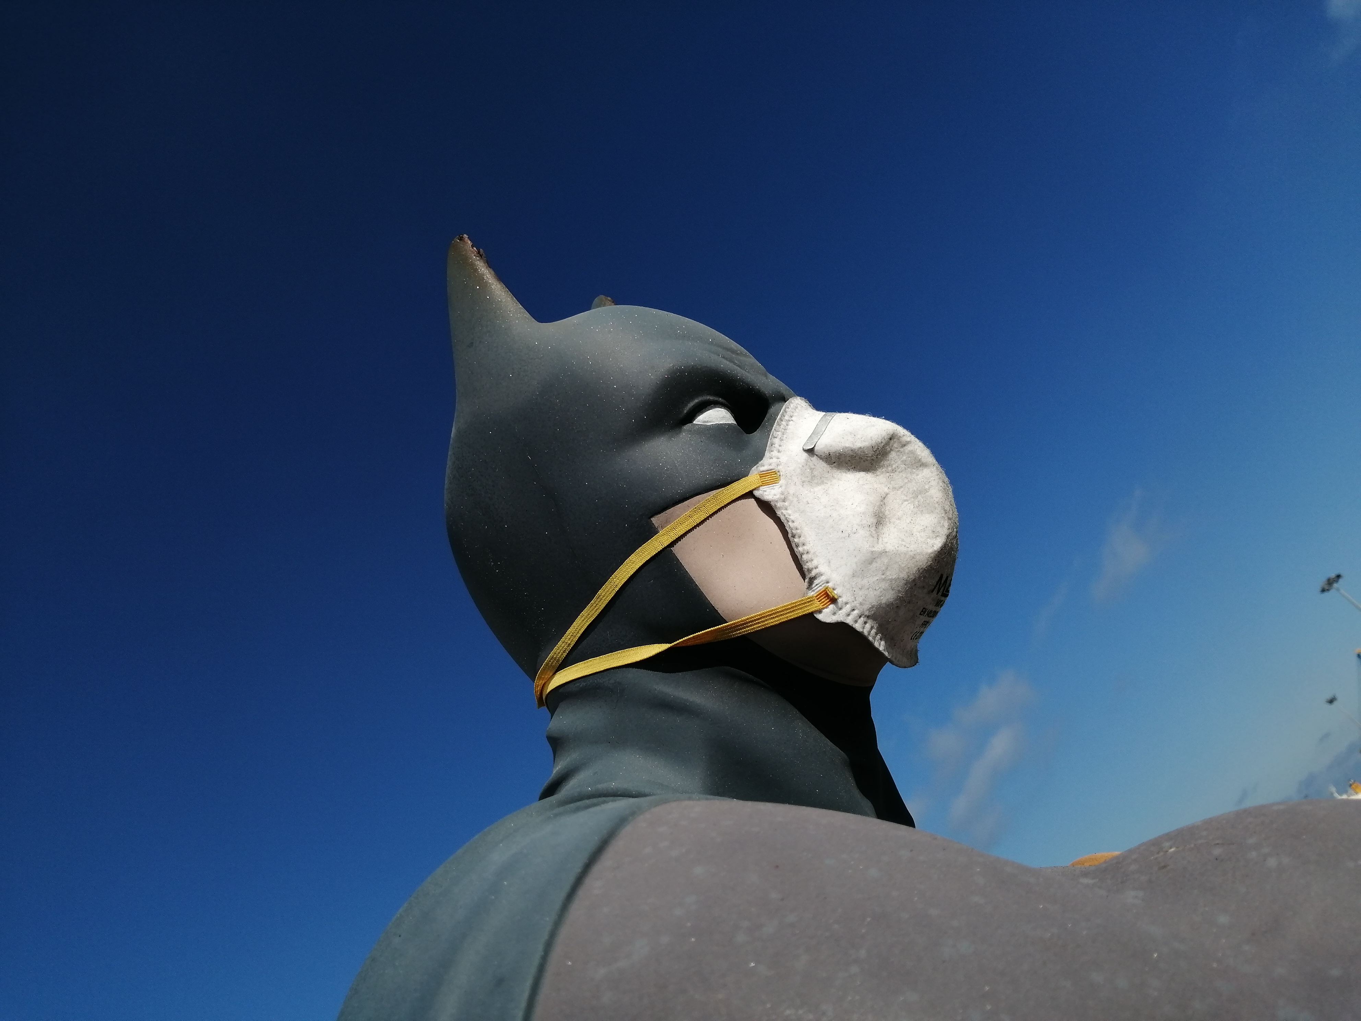
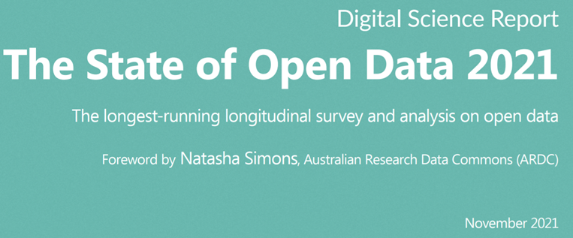
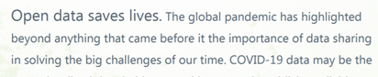
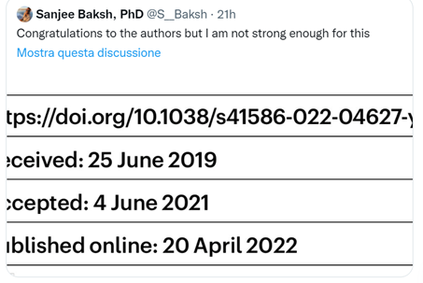
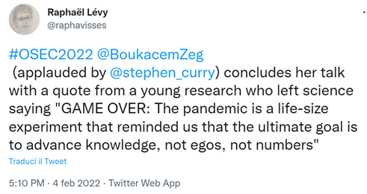
Contextualizing: COVID
BECAUSE OPEN DATA SAVES LIVES
Nov. 29 2021
QUESTION #1: ARE YOUR DATA AND PAPER AVAILABLE? AND WHEN?
WE NEED DATA, NOT ONLY ARTICLES, AND WE NEED BOTH NOW (NOT IN 3 YEARS)
THE PANDEMIC IS A LIFE-SIZE EXPERIMENT THAT REMINDED US THAT THE ULTIMATE GOAL IS TO ADVANCE KNOWLEDGE, NOT EGOS, NOT NUMBERS
Feb. 4 2022

Slide 5
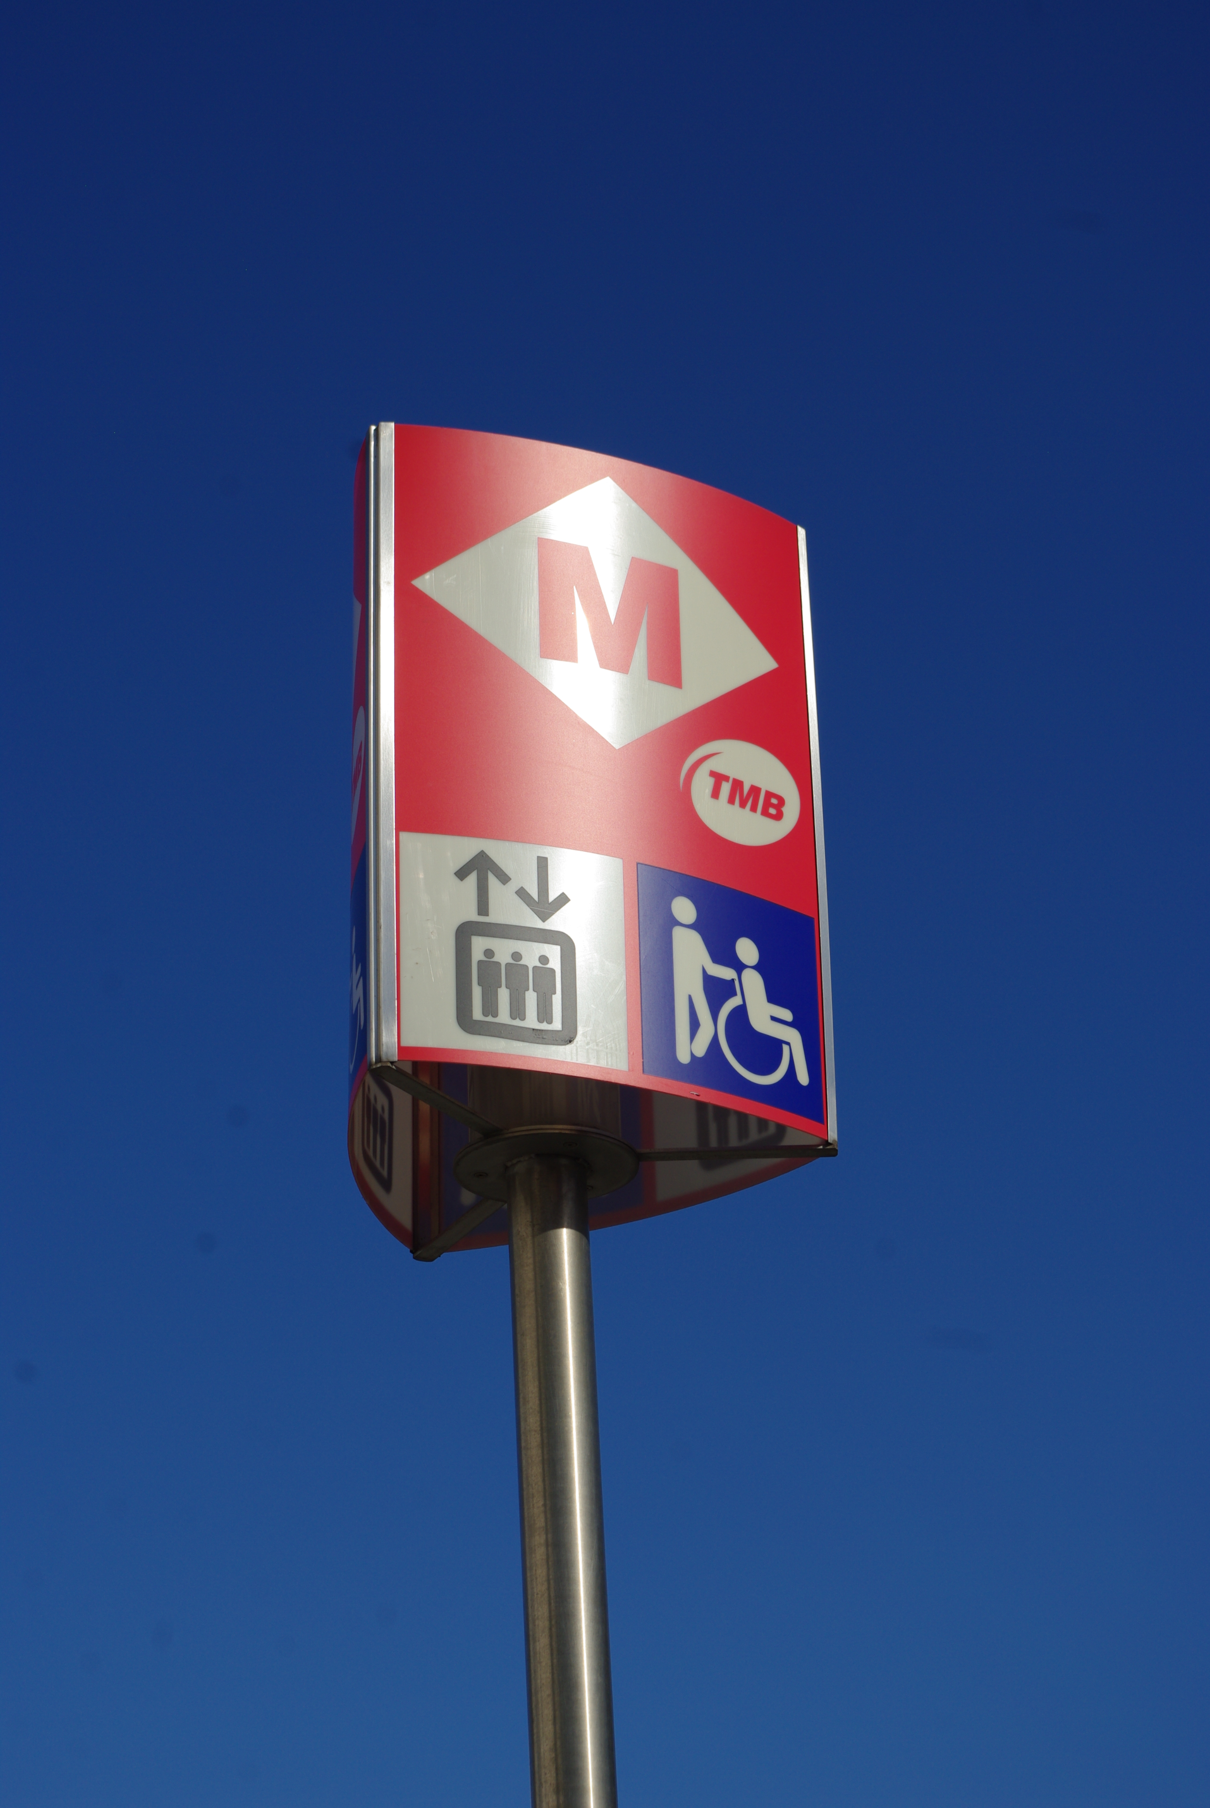
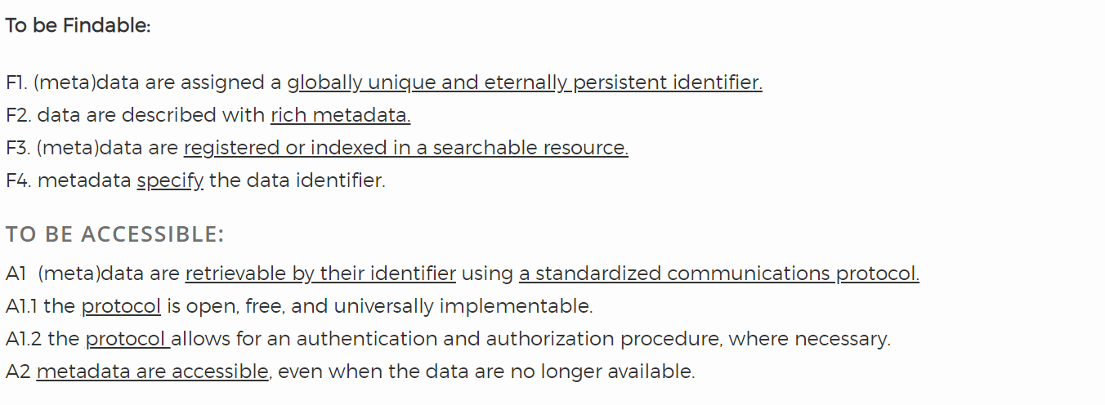

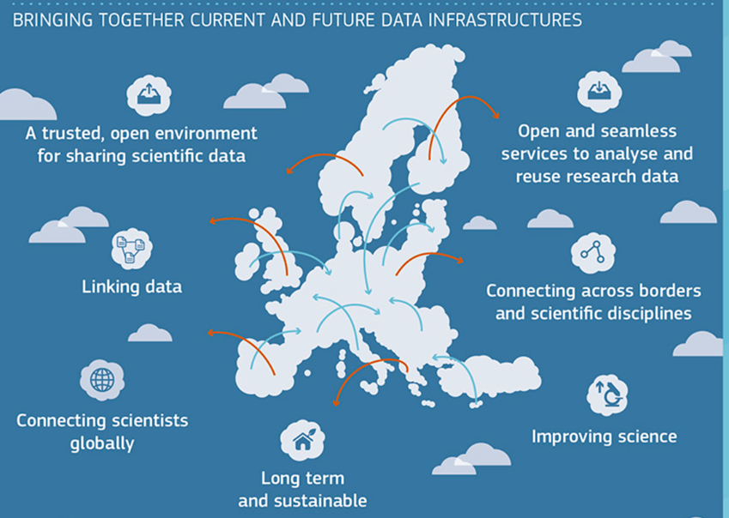
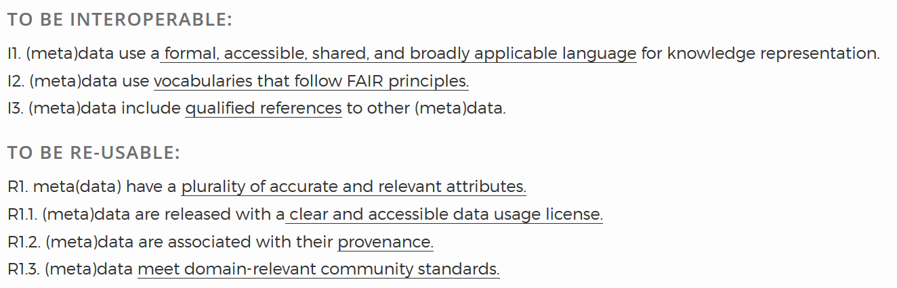
FAIR principles
QUESTION #2: ARE YOU DATA FAIR? DO YOU HAVE A DATA MANAGEMENT PLAN?
FAIR ARE THE BUILDING BLOCKS OF EOSC
Force 11

Slide 6
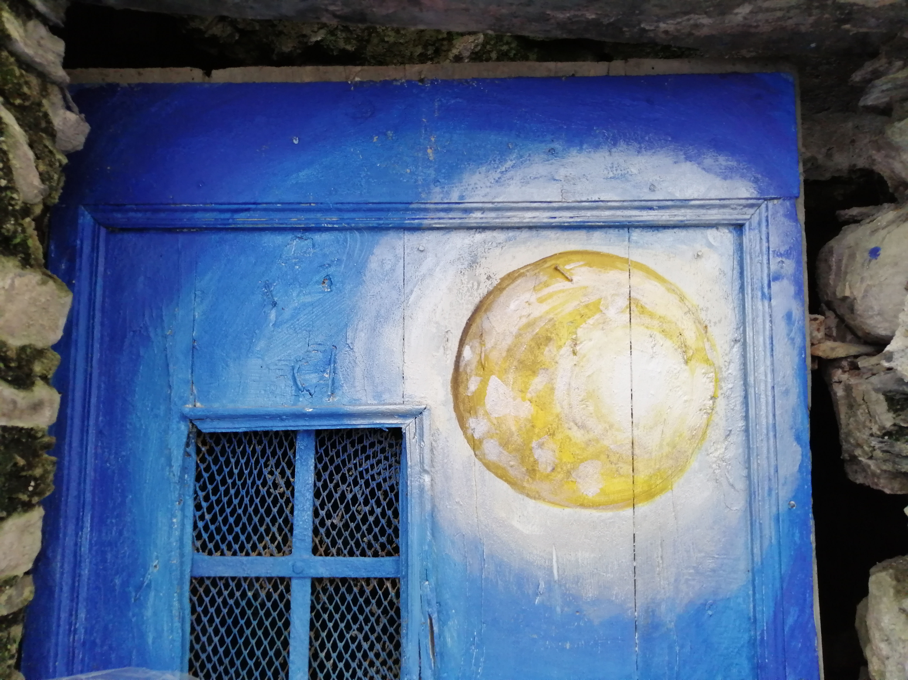
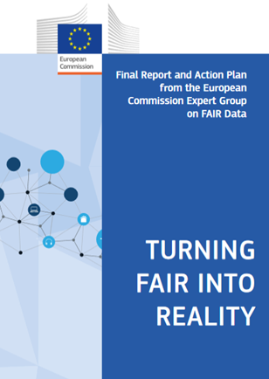
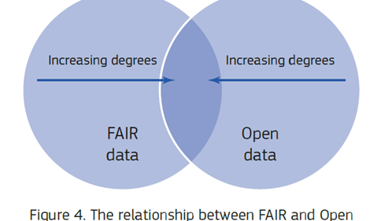
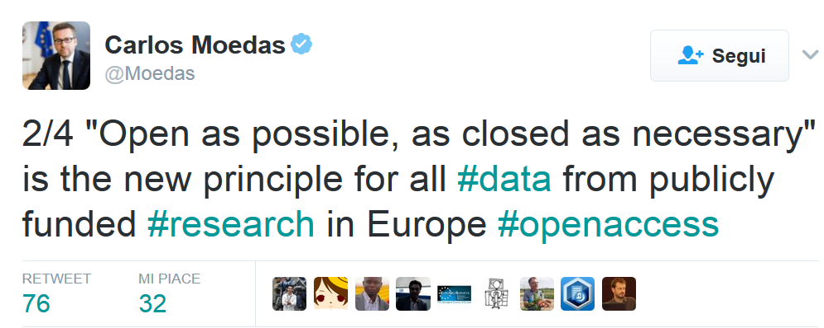
FAIR/Open
QUESTION #3: [YOUR QUESTION] «DO YOU WANT ME TO PUT ALL MY DATA IN THE OPEN? IT’S OFF THE TABLE. NO WAY»
«ACCESSIBLE»
DOES NOT MEAN «OPEN».
YOU – AND MACHINES - KNOW WHERE TO FIND THEM AND UNDER WHAT ACCESS CONDITIONS
2018
«AS OPEN AS POSSIBLE, AS CLOSED AS NECESSARY»
THERE WILL BE AN INCREASING DEGREE IN OVERLAPPING. BUT WE’LL ALWAYS HAVE PERFECTLY FAIR CLOSED DATA

Slide 7
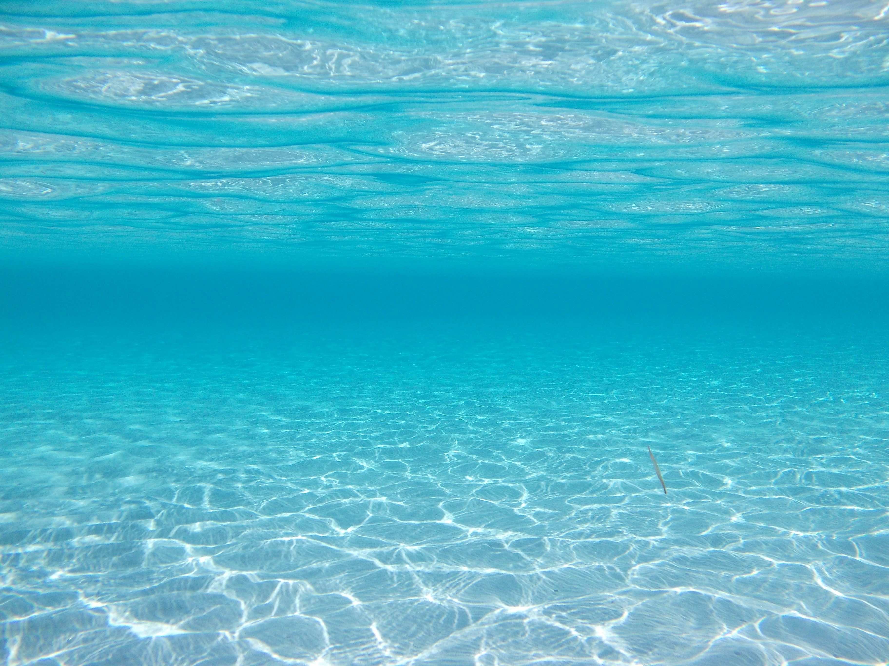
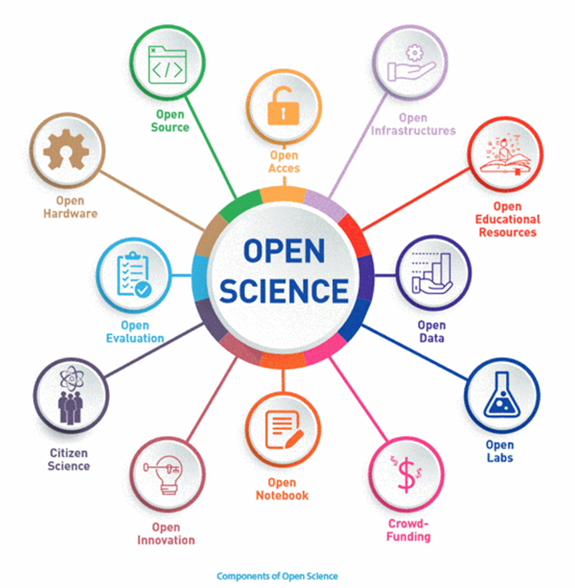
…Open Science
QUESTION #4: DO YOU KNOW THAT OPEN SCIENCE ≠OPEN ACCESS?
THE SAME PRINCIPLE APPLIES TO ALL OPEN SCIENCE COMPONENTS
UNESCO

Slide 8
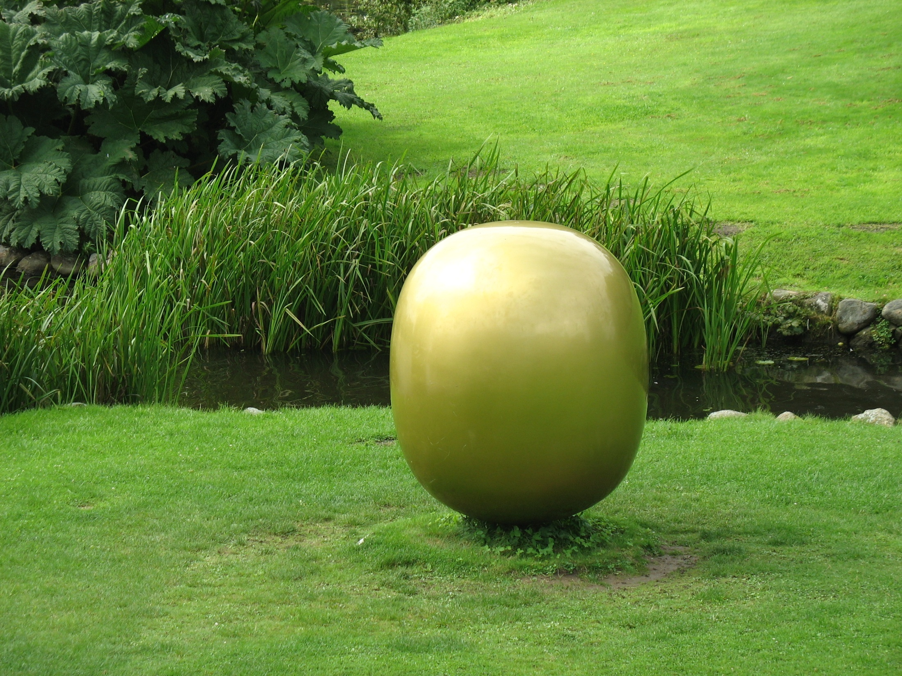
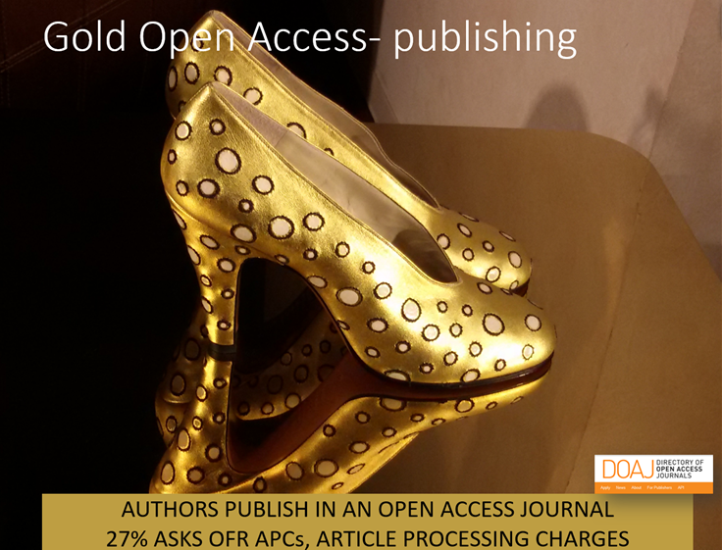
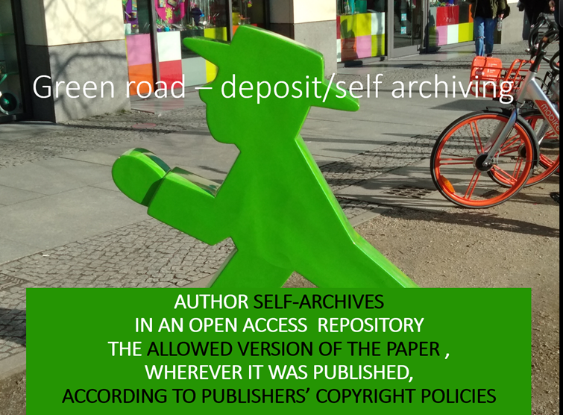
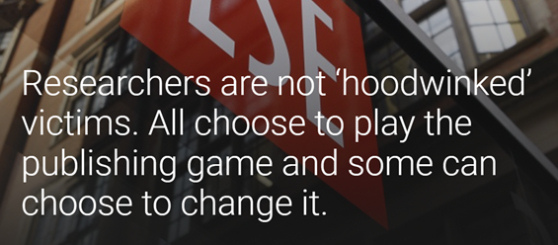
Green and Gold Open Access
QUESTION #5: DO I ALWAYS HAVE TO PAY WHEN I PUBLISH OPEN ACCESS?
AUTHORS PUBLISH IN AN OPEN ACCESS JOURNAL
30% ASK FOR APCs, ARTICLE PROCESSING CHARGES
…WE’LL DISCUSS ALSO «PREDATORY»

Slide 9
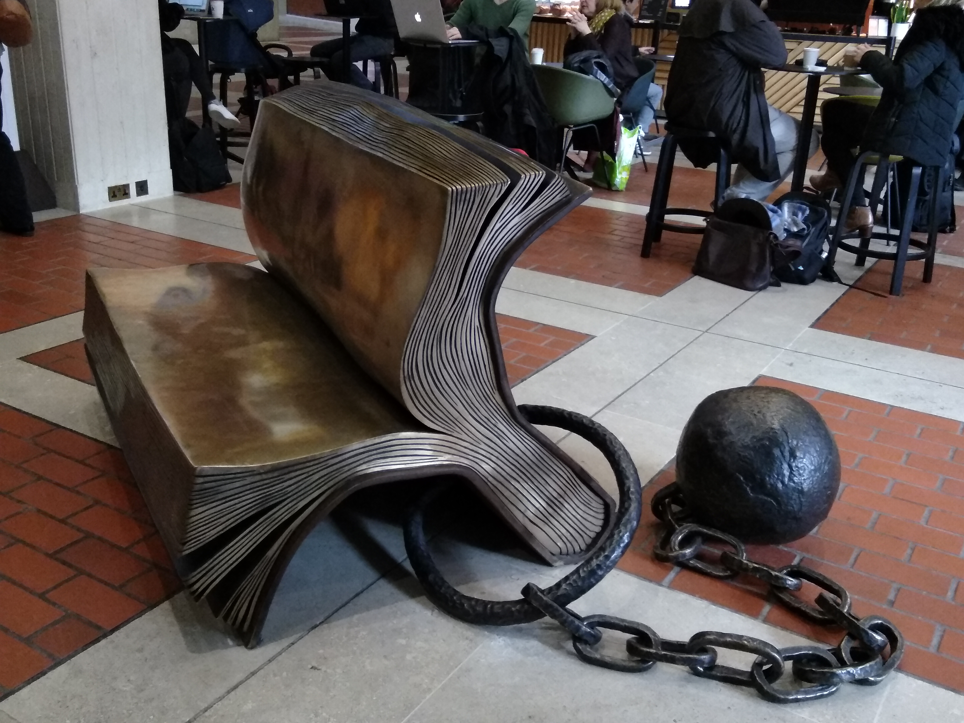
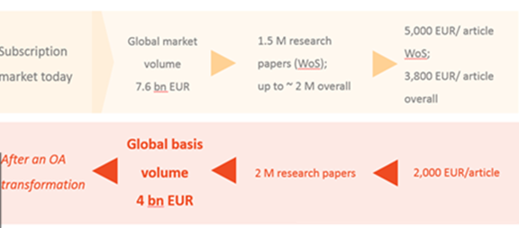
… scholarly communication today…
QUESTION #6: TODAY, READING IS FOR FREE, SO WHY SHOULD I PAY TO PUBLISH?
READING IS NOT FOR FREE
2016
7.6 billion $
TODAY, WE PAY 3800/5000 $ PER ARTICLE IN THE SUBSCRIPTION SYSTEM
[UNDERESTIMATED] AMOUNT OF MONEY SPENT IN SUBSCRIPTION IN 2016
WE PAY TO CLOSE

Slide 10
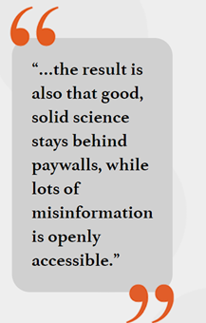
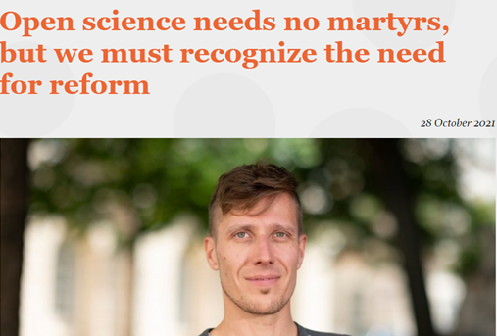
[point #2]
Oct. 28 2021

Slide 11
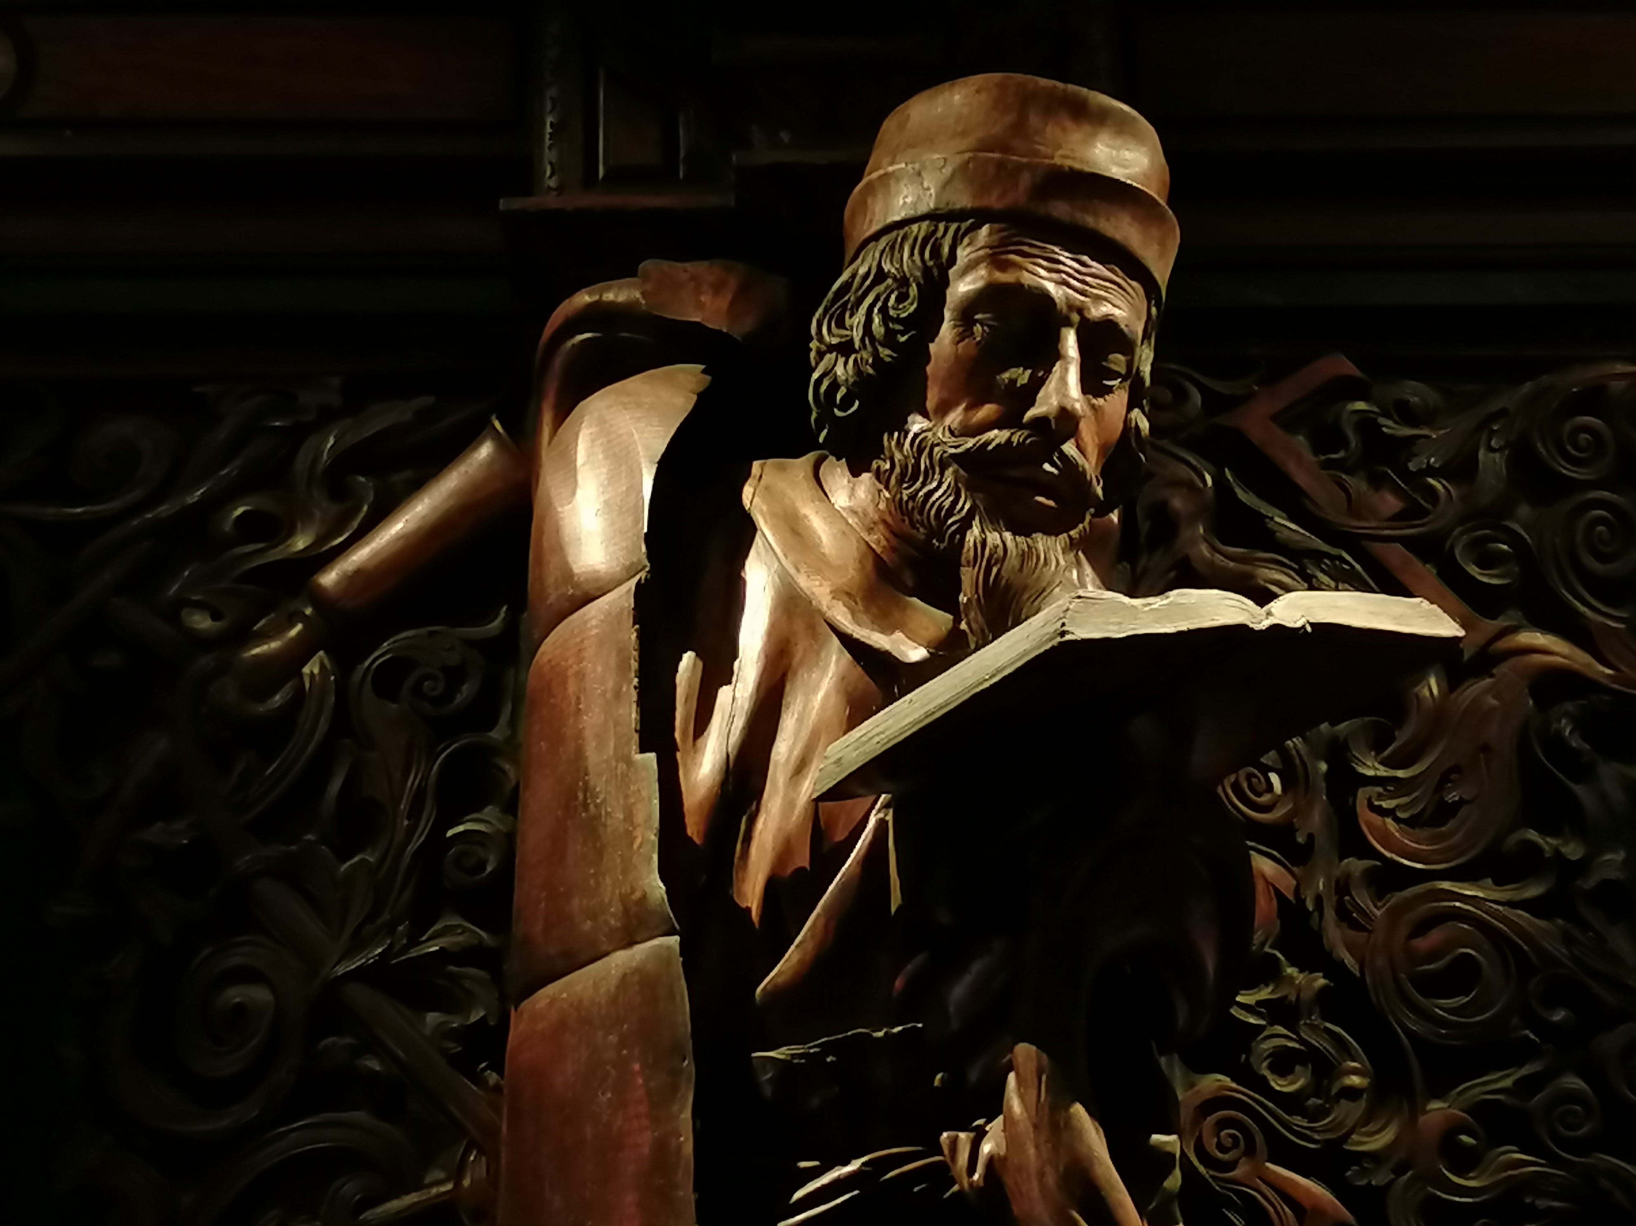
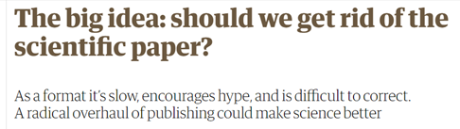
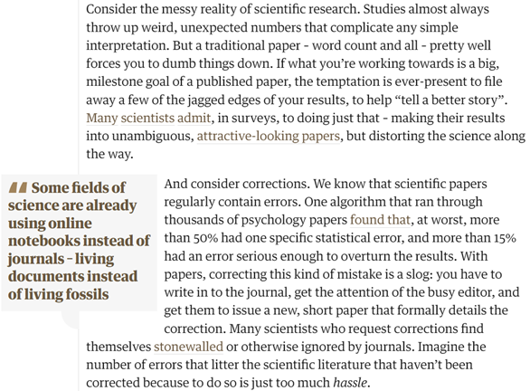
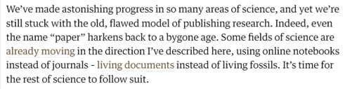
Living documents instead of living fossils
Apr. 11, 2022
QUESTION #7:
DO WE STILL NEED JOURNALS?
OLD FASHIONED, BIASED, NOT EFFECTIVE… LIVING FOSSILS. GET RID OF JOURNALS, USE NOTEBOOKS INSTEAD

Slide 12
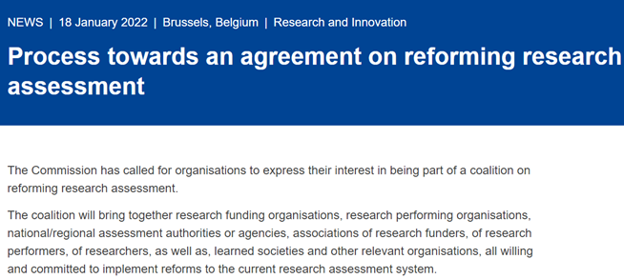
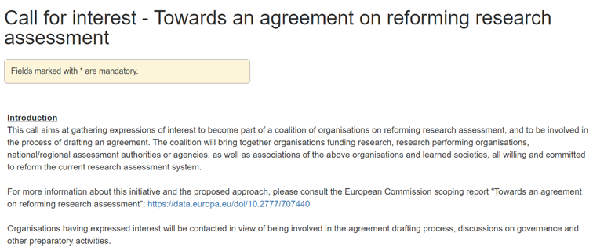
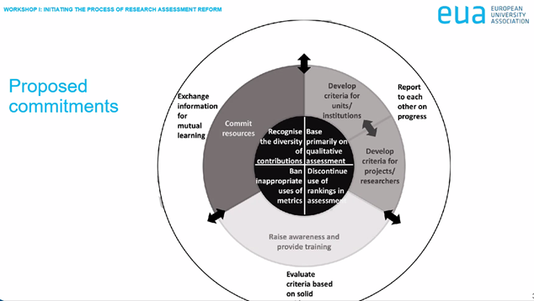
[point #3]
ARE WE FINALLY GOING TO GET RID OF IMPACT FACTOR AND PRESTIGIOUS JOURNALS?
EC process
Call for interest
THE EC INITIATIVE TOWARDS A REFORM OF RESEARCH ASSESSMENT IS GOING AT A SPEEDY PACE
SEPT. 2022 SIGN THE AGREEMENT
BY 2023 SHOW THE ROADMAP
BY 5 YEARS SHOW THE RESULTS

Slide 13
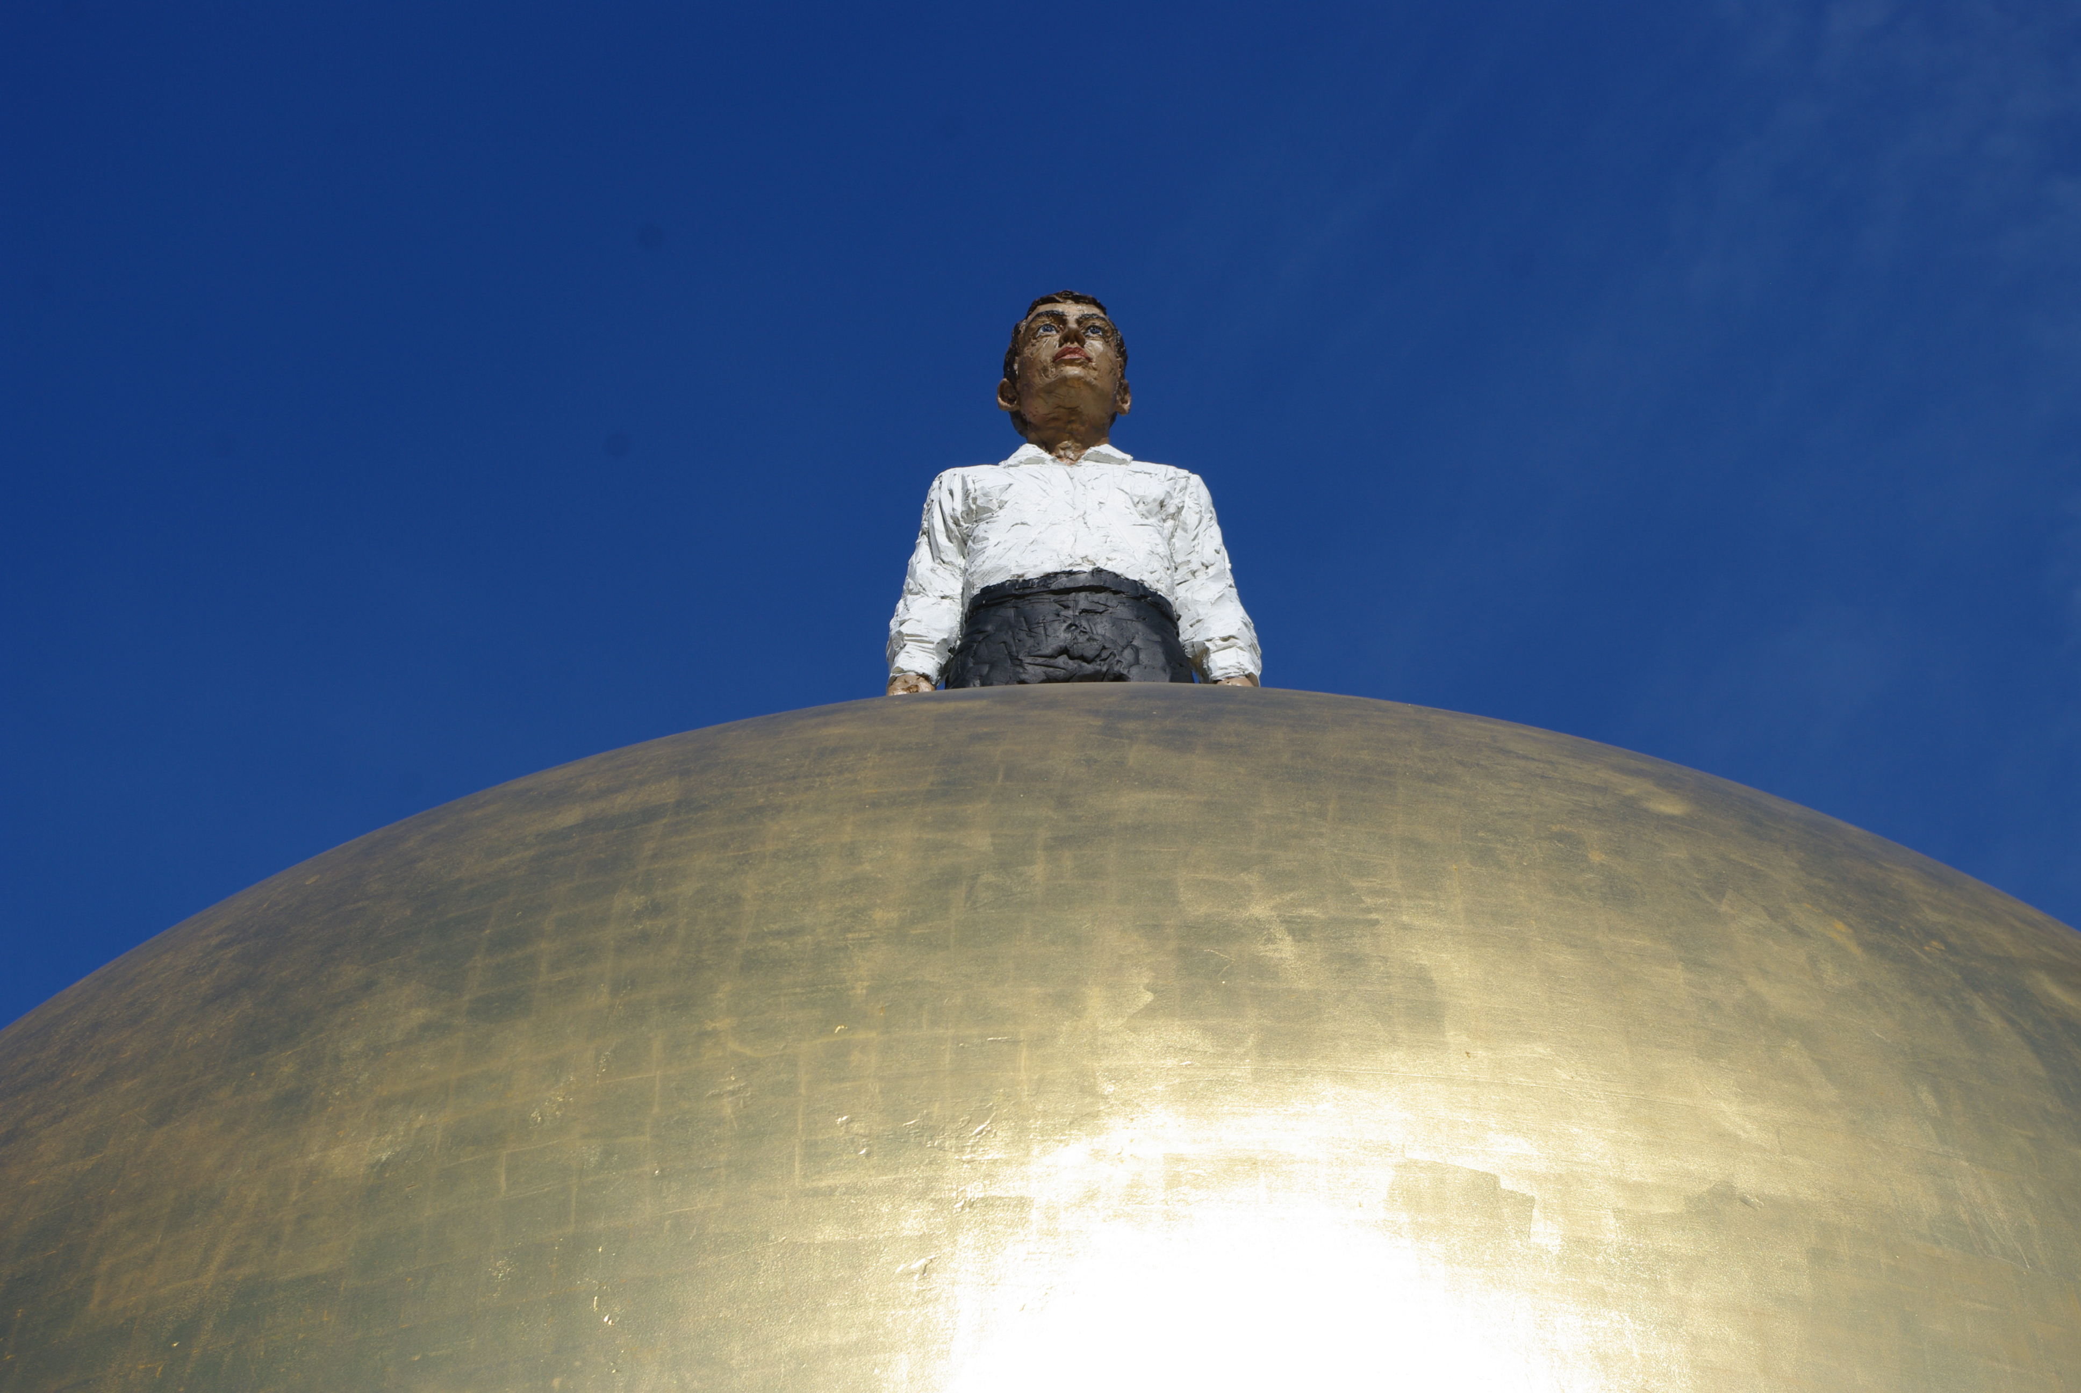

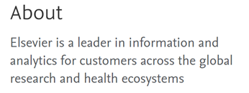
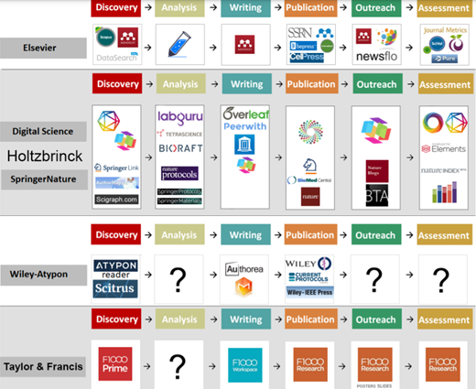
…still publishers?
NO LONGER «PUBLISHERS» EVEN ON THEIR HOMEPAGE
QUESTION #8: DO YOU KNOW THAT YOUR SEARCHES ON PLATFORMS ARE TRACKED?
Sept. 24, 2021
…ALL THE MAJOR PUBLISHING BRANDS ARE EXPANDING BEYOND PUBLICATIONS [MOSTLY TOWARDS DATA ANALYTICS]

Slide 14
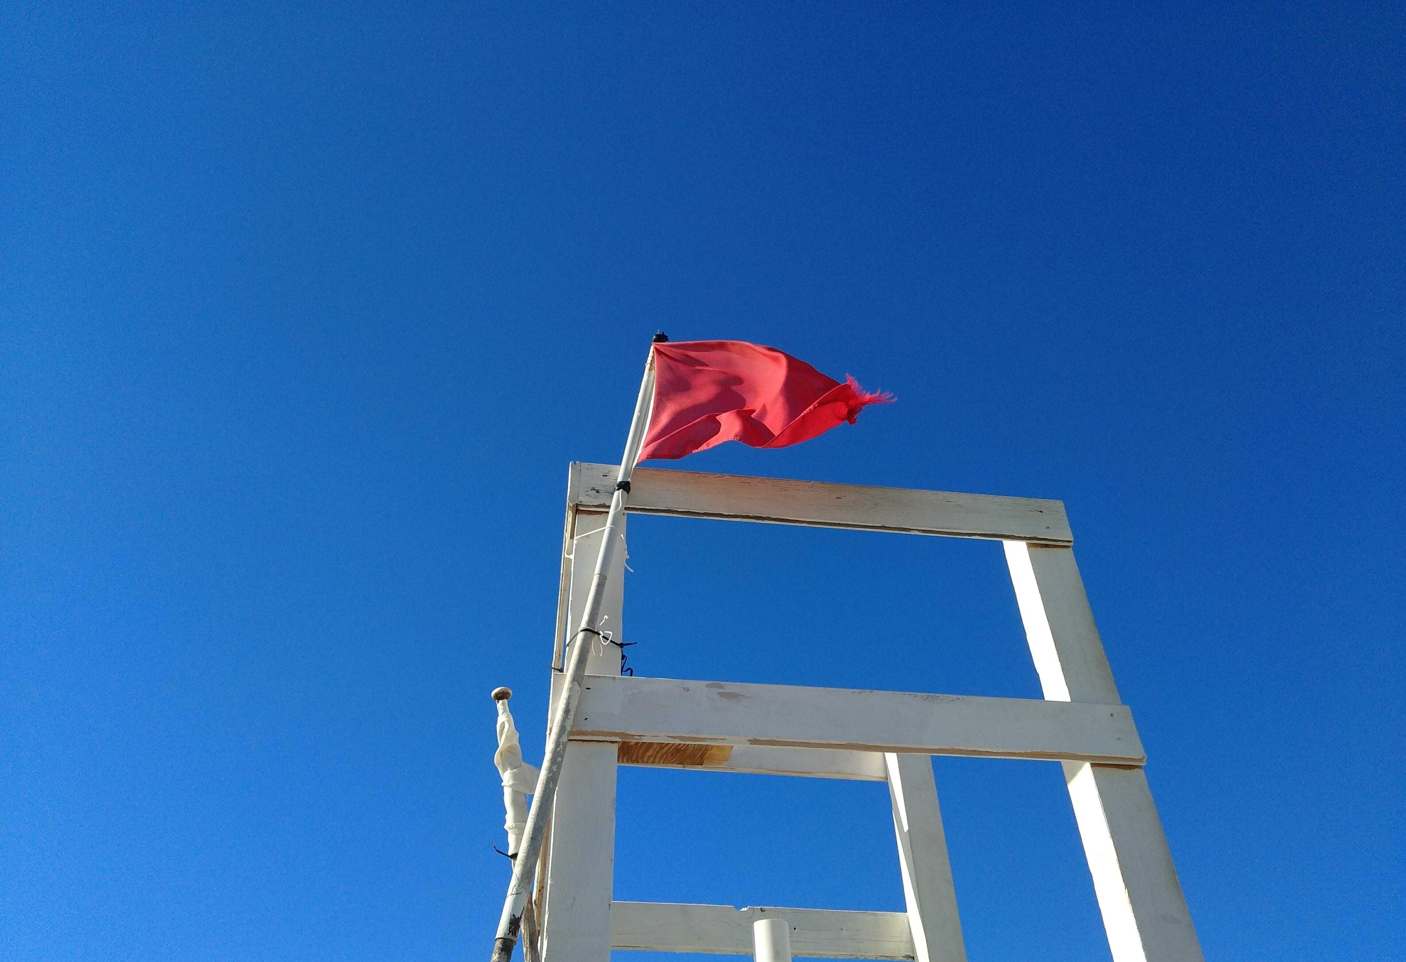
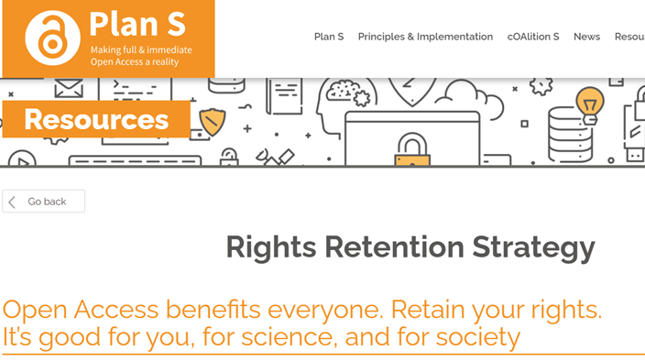
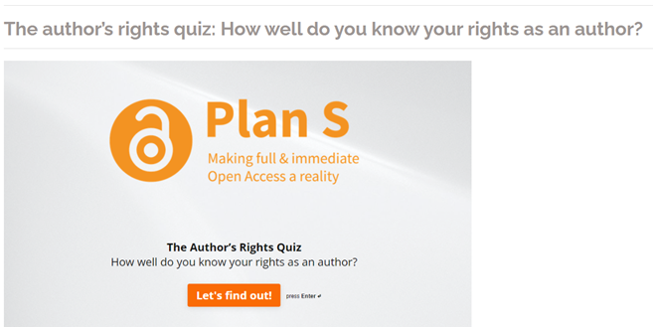
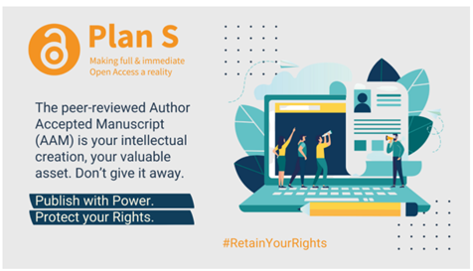
… your rights
QUESTION #9: ARE YOU AWARE OF YOUR RIGHTS AS AUTHORS?
2022
YOUR INTELLECTUAL PRODUCTION IS YOURS. DON’T GIVE IT AWAY!!!

Slide 15
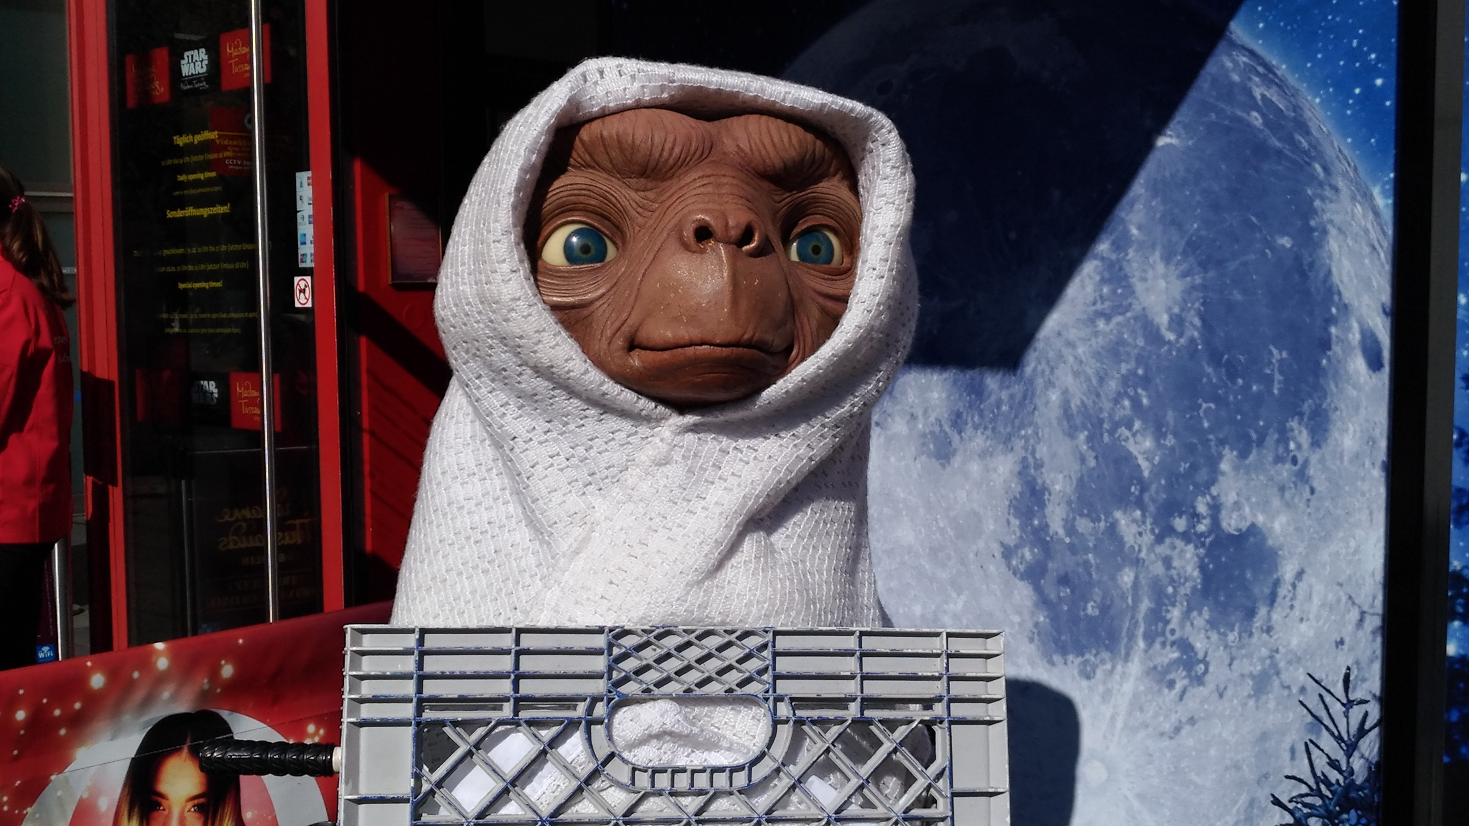

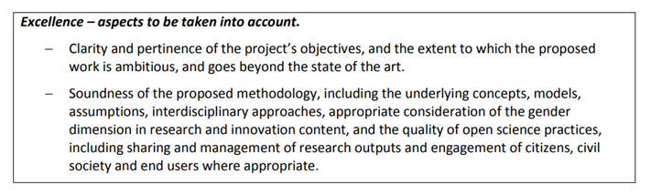
… calling [or: why should we care?]
QUESTION #10: ARE YOU AWARE THAT IN HORIZON EUROPE YOUR PROPOSAL WILL BE EVALUATED ALSO ON OPEN SCIENCE AND FAIR DATA MANAGEMENT?
Webinar 2021
Application template
OPEN SCIENCE IS A METHODOLOGY.
THAT’S WHY IN HORIZON EUROPE IT HAS BEEN MOVED TO THE «EXCELLENCE» SECTION OF THE PROPOSAL TEMPLATE… AND YOU WILL BE EVALUATED ON HOW YOUR PROPOSAL ADOPTS/ADAPTS OS PRACTICES

Slide 16

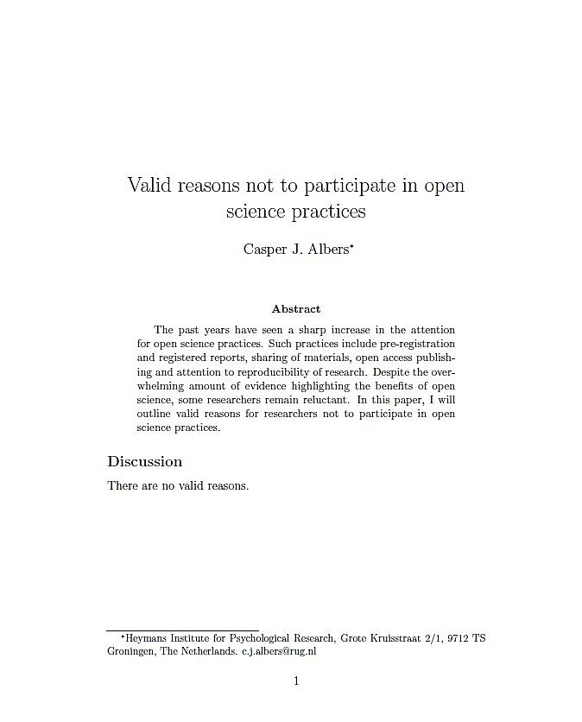
Reasons NOT to go Open Science?
SEE YOU TOMORROW AT 14.00!
https://twitter.com/CaAl/status/966279936028958720

